Slide 1
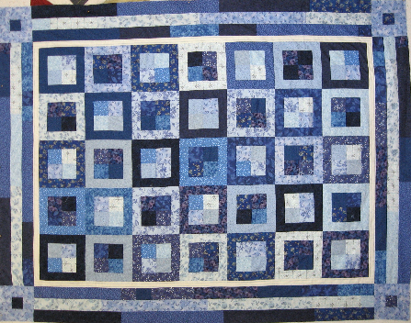
QUILT
A Patchwork of Multicast Regions
Qi Huang
Ýmir Vigfússon
Ken Birman
Haoyuan Li
Cornell University
IBM Research Haifa Labs
Cornell University
Cornell University

Slide 2
Pub/sub transport
Pub/sub over WAN has plethora of modern uses
  Facebook and Twitter real-time feeds
  Web and cloud management
  Massive multiplayer online games (MMOGs)
  Component of numerous DEBS applications
What about multicast over WAN?
  Multicast: One-to-many message dissemination
  A natural transport mechanism for pub/sub
  Wishlist:
    Minimize redundant traffic
    Minimize average latency of delivery yet with high throughput
    Limit per-node storage requirements
    Stay robust to node churn/failures
    Automatically adapt to the runtime environment

Slide 3
Status of Multicast
IP-multicast (IPMC)
  Disabled over WAN links
    Security concerns (DDoS attacks)
    Economic issues (how do you charge for IPMC?)
  Enabled in many data centers
    Possible to fix scalability and reliability issues
Application-level multicast (ALM)
  Iterated unicast does not scale ⇨ Use an overlay
  Dissemination overlays ignore underlying topology and IPMC
  Peer-to-peer structures usually vulnerable to churn
  Mesh solutions have high overhead and increase latency
No known solution achieves all of our goals
  Can one size fit all?

Slide 4
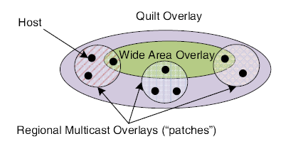
Introducing Quilt
Quilt weaves multicast regions into a patchwork:
  Discovers context automatically
  Optimizes efficiency
  Exports a simple library interface for developers
  Routes messages between regions
  Allows administrators to impose policy (e.g. enable IPMC)
Idea: What if we combine multiple multicast solutions?

Slide 5
Talk Overview
Motivation
Quilt Overview
Environment Identifier (EUID)
Quilt Architecture
Bootstrap server
Churn resilience
Duplication suppression
Evaluation
Data Center Topology
Internet Topology
Conclusion

Slide 6
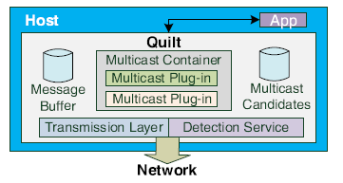
Quilt Overview
Quilt exposes a simple multicast API to end-user applications
The multicast container stores active protocol “objects”

Slide 7
Multicast Protocols
Quilt prototype supports three multicast protocols
  IPMC
    Network-level IP multicast
  DONet (CoolStreaming)
    Mesh-structured multicast
    BitTorrent-style content dissemination
  OMNI
    Tree-based latency-aware multicast
    Optimizes average latency from source without burdening internal nodes
    Quilt uses OMNI for global patch multicast

Slide 8
Quilt Overview
Quilt exposes a simple multicast API to end-user applications
The multicast container stores active protocol “objects”
The detection service discovers environment properties
  NATchecker, traceroute, latency + bandwidth statistics
  Constructs environment identifier (EUID)

Slide 9
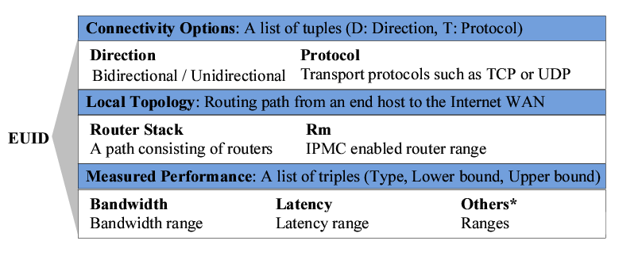
Environment Identifier
For each NIC, what transport protocols are supported and in which direction?
74% of hosts run behind NAT boxes and firewalls
  These hosts might be limited to a leaf-role

Slide 10
Environment Identifier
Trace the routing path to the local DNS server
  If two hosts share a DNS server or an intermediate router within 5 hops, then belong to the same AS with 85% probability
Check for IPMC capabilities as well

Slide 11
Environment Identifier
Periodically estimate network performance
Fluctuates over time, so measurements encoded as ranges of values

Slide 12
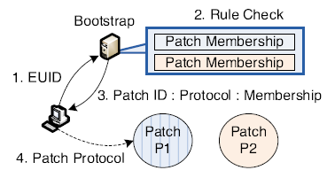
Patch formation
Bootstrap sequence
  New host generates EUID for each NIC
  Sends EUID to bootstrap server
  Receives EUIDs for initial contacts in compatible regions
Rules
  Patches defined by EUIDs based on ALM rules
  E.g. if IPMC enabled router is shared between E₁ and E₂, a region is formed with EUID E_{1,2}
  Members eventually get a single maximal EUID
Global patch
  A wide-area overlay connects other regions
  Overlaps in some representative node for each patch

Slide 13

Bootstrap server
Three main roles
  Maintain partial membership for each patch
  Structure nodes into patches
  Ensure health of global patch
Off the critical path
  Only used on joins and when nodes become isolated
Gossip version of Quilt
  Distributed maintenance of membership.
  Alleviates single-point-of-failure concerns

Slide 14
Churn resilience
Each patch has a representative node
  Tunnels traffic between the patch and the global patch
What about churn?
  The quilt overlay may partition if the representative leaves
For robustness, Quilt has k representatives in each patch
  Here k is a small number, like 2 or 3
  Increasing k in turn increases message duplication
Quilt is able to recover after failure
  Hosts periodically report to the bootstrap server, ensuring fresh membership snapshot
  Representatives are monitored and new ones appointed if they die

Slide 15
Duplication suppression
More representatives ⇨ more duplicates
Suppressing duplicates per host
  Each host maintains a Bloom filter, and marks incoming messages
  Reset filter periodically depending on multicast data rate
Suppressing duplicates among representatives
  Gossip-based protocol links patch representatives within multicast region
  Since k is tiny, use simple 2-phase synchronization protocol

Slide 16
Talk Overview
Motivation
Quilt Overview
Environment Identifier (EUID)
Quilt Architecture
Bootstrap server
Churn resilience
Duplication suppression
Evaluation
Data Center Topology
Internet Topology
Conclusion

Slide 17
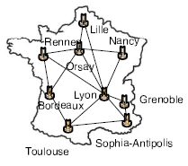
Data Center Topology
Application: Publish/subscribe event notification among data centers linked on Internet WAN.
Grid5000 structure links 25 clusters (1531 servers) from 9 locations in France
Sub-millisecond latencies within clusters, 4-6ms between sites
Assumptions:
  Single-source multicast
  IPMC is enabled within each site, but not between them

Slide 18
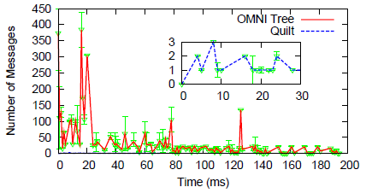
Data Center Topology
Overhead: Quilt has substantially less network overhead than pure OMNI for constructing the overlay.
  The Quilt overlay trees are much smaller.

Slide 19
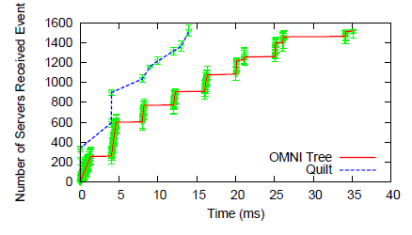
Data Center Topology
Latency: Quilt leverages IPMC to accelerate event dissemination unlike the system-wide OMNI tree.

Slide 20
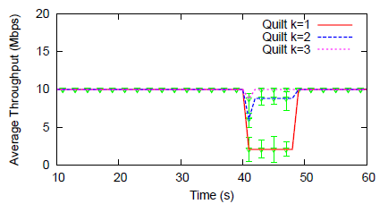
Data Center Topology
Churn resilience: Quilt recovers quickly even from catastrophic failures (50% of nodes randomly die), or within 10 seconds.
# of Patch Representatives
50% of nodes die

Slide 21
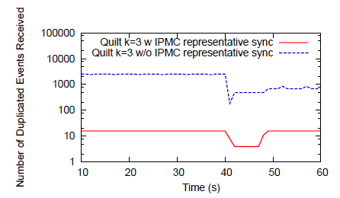
Data Center Topology
Duplication suppression: Bloom-filters and 2-phase synchronization among representatives are effective.
50% of nodes die

Slide 22
Internet Topology
Application: Internet-wide dissemination
  A synthetic collection of 951 Internet hosts
  End-to-end latency between hosts from PeerWise
  Selected random hosts from CAIDA traceroute records with similar host-to-host latencies and gathered route information
Assumptions:
  Single-source multicast
  IPMC is not enabled
Quilt uses DONet within patches and OMNI between them

Slide 23
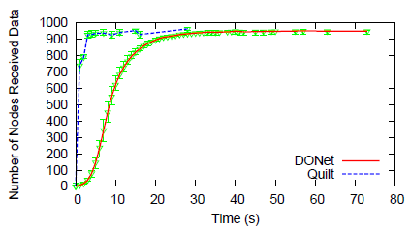
Internet Topology
Latency: Quilt disseminates data quicker than DONet by avoiding expensive BitTorrent-style scheduling cycles.

Slide 24
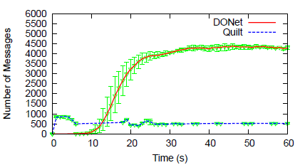
Internet Topology
Overhead: Quilt avoids the BitTorrent-style overheads experienced by DONet.

Slide 25
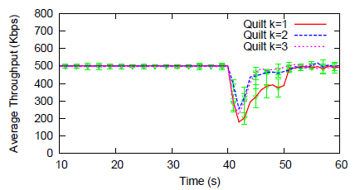
Internet Topology
Churn resilience: Many small regions makes recovery harder, but still relatively quick.
Duplication suppression: 50% fewer duplicates when k=2, 63% lower when k=3.
50% of nodes die

Slide 26
Conclusion
Impractical to create a one-size-fits-all multicast solution
  Many internet nodes separated by WAN links
  Small clusters of nodes residing behind NAT or firewall
  Larger clusters in settings where IPMC is available
Quilt weaves a patchwork of multicast regions
  Automatic environment detection and region formation
  Resilient to churn and suppresses duplicates
  Lightweight and scalable multicast service
Quilt actually works!
  Free download at Cornell’s Live Distributed Objects site:
  http://liveobjects.cs.cornell.edu

