Slide 1
SVE: Distributed Video Processing at Facebook Scale
Qi Huang
Petchean Ang, Peter Knowles, Tomasz Nykiel, Iaroslav Tverdokhlib,
Amit Yajurvedi, Paul Dapolito IV, Xifan Yan, Maxim Bykov, Chuen Liang, Mohit Talwar, Abhishek Mathur, Sachin Kulkarni, Matthew Burke, Wyatt Lloyd
Facebook, University of Southern California, Cornell, Princeton
Notes:
Hi, my name is Qi Huang.
I’m excited to tell you about SVE, a system built to overcome all the challenges we encountered when scaling video processing at Facebook, to many application, product developers, and especially the volume of uploads.

Slide 2

Video is growing across Facebook
FB: 500M users watch 100M hours video daily (Mar. 16)
Instagram: 250M daily active users for stories (Jun. 17)
All: many tens of millions of daily uploads, 3X NYE spike
01
Notes:
Video is an important part of many of our apps and services at Facebook, here are a few notable examples many of you have already known.
It has also grown significantly over the past few years. By early 2016, it is reported that 500M users are watching 100M hours worth of video every day on FB. Just a couple of months back, we have shared the stats that IG has attracted 250M users actively creating and sharing instant video stories on a daily basis as well.
Collectively, all our applications are generating many tens of millions of daily uploads, and this traffic can even spike higher during viral events like NYE.

Slide 3

Processing is diverse and demanding
Processing
Input video
Re-encoding
Video Classification
Thumbnail
Pt. 1
Legacy System
Scaling Challenges
Pt. 2
SVE
Impact of Design
02
Notes:
When those videos are uploaded, all apps and services need to process them, and here are some common examples: including encoding, thumbnail extraction, and video classification.
In particular, the re-encode is computationally intensive, and we need that for smooth streaming.
b) In this talk I’ll first tell you about our legacy video processing system and the challenges we faced in getting it to scale to many applications and many videos
c) Then I’ll describe SVE, and how it overcomes each of those challenges

Slide 4

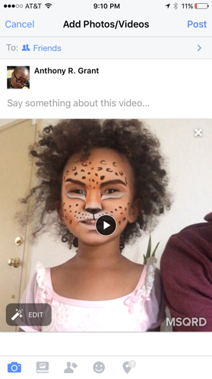
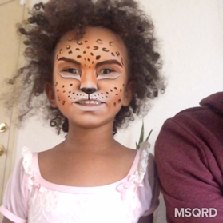
Legacy: upload video file to web server
Client
Web Server
She is having so much fun with #MSQRD
03
Notes:
So when user creates a post with video, the first stage is to upload the video file into FB’s datacenter, where our web server tier is responsible for receiving the file.

Slide 5
Legacy: preserve original for reliability
Client
Web Server
Original
Storage
She is having so much fun with #MSQRD
04
Notes:
Web server preserves the upload into a replicated original storage. So that when uploads get interrupted, we can resume easily.

Slide 6
Legacy: process after upload completes
Client
Web Server
Original
Storage
Processing
She is having so much fun with #MSQRD
05
Notes:
When upload finishes, web server would trigger the processing stage. There are many different types of processing we conduct on an upload, and the most resource demanding one is re-encoding.

Slide 7
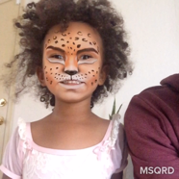

Legacy: encode w/ varying bitrates
Client
Web Server
Original
Storage
Processing
720P
4Mbps
She is having so much fun with #MSQRD
1080P
16Mbps
480P
1.5Mbps
06
Notes:
Why do we need to re-encode?
A video recorded on high-end phones could be of really high quality as 1080p with up to 16Mbps bitrate. But this is not the bandwidth available everywhere around world. To stream globally with varying devices and network conditions, we need to compress the video into different bitrates and formats. And in this case, we compress them into smaller 720P and 480P.

Slide 8
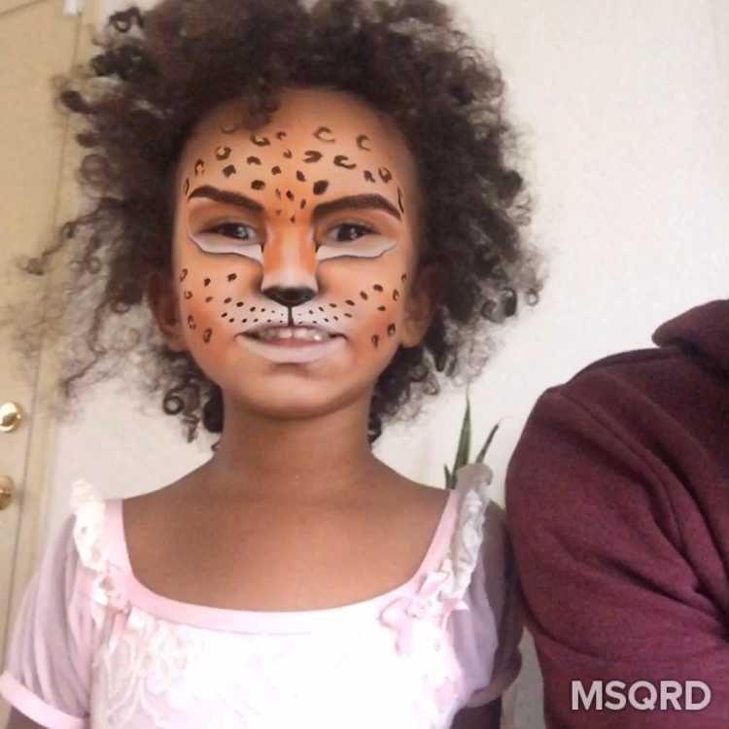
Legacy: store encodings before sharing
Client
Web Server
Original
Storage
Processing
Final
Storage
720P
4Mbps
She is having so much fun with #MSQRD
1080P
16Mbps
480P
1.5Mbps
07
Notes:
After processing, encoded files and other results are stored for later streaming.

Slide 9
Sharing with adaptive streaming
Client
Web Server
Final
Storage
720p
480p
FBCDN
08
Notes:
When sharing, your friends would typically receive an notification. Once your friend decides to play, client picks the best quality available for its environment, and start streaming through CDN.

Slide 10
Focus: pre-sharing pipeline
Client
Web Server
Original
Storage
Processing
Final
Storage
All steps from when a user starts an upload until a video is ready to be shared
09
Notes:
In this talk, we focus on solving the problem in this pre-sharing pipeline.
And what I meant by pre-sharing covers all steps from the time when user starts an upload, until the video is ready to be shared.

Slide 11
Serial pipeline leads to slow processing
Client
Web Server
Original
Storage
Processing
Final
Storage
10
Notes:
One obvious problem here, is the lack of parallelism. Which leads to large latency when processing complex and long videos.

Slide 12
Monolithic script slows development
“Let’s experiment speech recognition, add a logic to extract audio and analysis”
“Change color coding at different time”
Client
Web Server
Original
Storage
Processing
Final Blob Storage
“We need to change the thumbnail generation logic for videos > x minutes to create scene-based scrubber preview”
“Pass-through for small and well-formatted videos”
“We want to experiment AI-based encodings to spend 10x CPU for 30% compression improvement on popular videos”
11
Notes:
Another pain point is the Processing itself, which is essentially a monolithic script with stack of functions created many years ago.
When Facebook started to invest more into video, more people wanted to make changes into the processing stage. Such as adding speech recognition, changing the way we generate thumbnail, or even applying AI-based encoding techniques. The list goes on. And the this monolithic encoder script made it hard for programmer to figure out where to put in their new logic without breaking any of the dependencies between parts of the script.

Slide 13
Challenges for video processing @ FB
Speedy
Users can share videos quickly
Flexible
Thousands of engineers can write pipelines for tens of apps
Robust
Handle faults and overload that is inevitable at scale
12
Notes:
In order to help scale video processing @ Facebook, there are three key challenges we need to address there.
First, it needs to be fast disregarding the video size and length. The sooner video processing finishes, our user would get more interactive experience.
Second, the solution needs to have a flexible interface so that our thousands of engineers can easily experiment new products.
Last, the system needs to work at scale, handling failures and overloads.

Slide 14
Our Streaming Video Engine (SVE) is speedy, flexible, and robust
13
Notes:
We overcame all these 3 challenges with Streaming Video Engine, and I will explain how we address each of them for the remainder of the talk.

Slide 15
Speedy: harness parallelism
Users can share videos quickly
Overlap fault tolerance and processing
Overlap upload and processing
Parallel processing
14
Notes:
Because all of you are systems experts you know how we’re going to speed this up: we find as much parallelism as possible.
Including overlap fault tolerance and processing, overlap upload and processing, and make processing itself parallel.
Our contributions here is specializing these techniques for video.

Slide 16
Architectural changes for parallelism
Client
Web Server
Original
Storage
Processing
Final
Storage
15
Notes:
In order to harness parallelism, SVE introduced some architectural changes towards the legacy pipeline.
We first moved Original Storage out of the critical path between upload and processing.

Slide 17
Architectural changes for parallelism
Scheduler
Client
Web Server
Preprocessor
Worker
Final
Storage
Worker
Worker
Original
Storage
16
Notes:
And replaced the monolithic script with a full-blown distributed system with three major components:
Preprocessor ( which prepares upload and keep them in cache for processing), Scheduler (which schedule processing tasks), and a large pool of workers (for actual task execution).

Slide 18
Overlap fault tolerance and processing
Scheduler
Client
Web Server
Preprocessor
Final
Storage
Write-through
Cache
Worker
Worker
Worker
Original
Storage
17
Notes:
Here is the easiest source of parallelism provided by this new architecture.
Preprocessor can work as a write-through cache.
Instead of letting Web Server write uploads into Original storage before triggering processing. We can directly takes video upload into Preprocessor for early access while storing into storage in parallel.

Slide 19
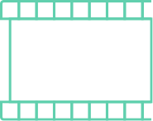
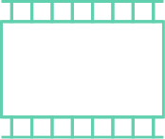
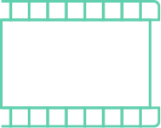



Overlap upload and processing
Scheduler
Client
Web Server
Preprocessor
Worker
Final
Storage
Worker
  Split into segments
Original
Storage
Worker
18
Notes:
Another technique is overlapping upload and processing.
Video is essentially a series of frames that can be split into multiple individual segments, each can be processed independently.
So when user uploads a video, instead of uploading it as a file, we can first split the video.

Slide 20
Overlap upload and processing
Scheduler
Client
Web Server
Preprocessor
Worker
Final
Storage
Worker
  ...upload in progress
Original
Storage
Worker
19
Notes:
The benefit of doing so is while the upload is still ongoing, SVE can start process any segment been uploaded.

Slide 21
Parallel processing w/ many workers
Scheduler
Client
Web Server
Preprocessor
720P Encode
Worker
Final
Storage
480P Encode
Worker
  ...upload in progress
Original
Storage
Worker
Thumbnail
20
Notes:
The processing itself is also parallelized.
SVE schedules different processing tasks onto different workers, in this example, it can be encoding into different qualities and thumbnail generation we saw earlier.

Slide 22
Parallel processing w/ many workers
Scheduler
Client
Web Server
Preprocessor
720P Encode
Final
Storage
480P Encode
  ...upload in progress
Original
Storage
Thumbnail
21
Notes:
On execution, each work pulls the data from Preprocessor cache, executes locally.

Slide 23
Parallel processing w/ many workers
Scheduler
Client
Web Server
Preprocessor
720P Encode
Final
Storage
480P Encode
  ...upload in progress
Original
Storage
Thumbnail
22
Notes:
On completion, results are stored in Final Storage in parallel, and all of this can happen at the same time when Preprocessor starts the procedure for another segment in flight.

Slide 24
Parallel processing w/ many workers
Scheduler
Client
Web Server
Preprocessor
Worker
Final
Storage
Worker
Original
Storage
Worker
23
Notes:
Until eventually all processed videos are stored in storage.

Slide 25
Three sources of parallelism
Scheduler
Client
Web Server
Preprocessor
Worker
Final
Storage
Worker
Overlap fault tolerance
and processing
Overlap upload and processing
Parallel processing
Original
Storage
Worker
24
Notes:
So in summary, SVE harness the parallelism from three sources:
1.
2.
3.

Slide 26
Results: 2.3x ~ 9.3x speedup
Relative speedup
Video size buckets
25
Notes:
To evaluate the effectiveness, we compared SVE with the legacy system during the rollout process back in 2015.
X axis shows the size buckets we compared videos between two systems.
Y axis shows the relative speedup from the time when video upload is finished to the moment video is ready to share. So upload time is not considered here.
Add X after each number

Slide 27
Results: 2.3x ~ 9.3x speedup
Overlap upload & processing
Relative speedup
Video size buckets
26
Notes:
Even for the smallest bucket of videos < 3MB, SVE provides 2.3 x speedup and mainly because of the capability of overlapping upload and processing.

Slide 28
Results: 2.3x ~ 9.3x speedup
Parallel Processing
Relative speedup
Video size buckets
27
Notes:
For videos with larger than 1G, we get 9.3, almost 10x speedup and here is where parallel processing played major factor.
What is particularly promising is the trend. Going into the future, when users have better network and devices, the video will only get larger and bigger speedup on larger video gives us confidence the system is future proof.

Slide 29
Challenges for video processing @ FB
Speedy
Users can share videos quickly
2.3x ~ 9.3x speedup
Flexible
Thousands of engineers can write pipelines for tens of apps
Robust
Handle faults and overload that is inevitable at scale
28
Notes:
So now we get speedy covered, let’s take a look on flexibility.

Slide 30
Flexible: build DAG framework
Thousands of engineers can write pipelines for tens of apps
DAG of computation on the stream-of-tracks abstraction
Engineers write only sequential tasks in a familiar language
Dynamic DAG generation per video
29
Notes:
The system needs to be flexible because we need to enable thousands of engineers write processing pipelines for tens of applications. And we need to achieve it in a way that we can still harness all the parallelism so the system is speedy.
We do this with DAGs of computation on …, so that engineers only need to write sequential tasks in a familiar language. We also make this flexible with per video DAG generation.

Slide 31



DAG on stream-of-tracks abstraction
$pipeline = Pipeline.build()
$video_track=$pipeline>addTrack(IMG_TYPE)
->addTask()
$audio_track=$pipeline>addTrack(AUD_TYPE)
->addTask()
$meta_track=$pipeline>addTrack(META_TYPE)
->addTask()
Images
Sound
Input
video
Metadata
Track
30
Notes:
A video is usually presented in a format of multiple tracks: visual, audio, and metadata.
SVE explicitly exposes them as individually into the programming interface, so our programmers can build tasks depending on each track. On the right side is a code example where tracks are separated, and we can build tasks depending on each.

Slide 32
DAG on stream-of-tracks abstraction
Encode(HD)
->addTask(Encode(HD), Encode(SD), Thumb)
->addTask(Encode(AAC))
->addTask(Analysis)
$pipeline = Pipeline.build()
$video_track=$pipeline>addTrack(IMG_TYPE)
->addTask()
$audio_track=$pipeline>addTrack(AUD_TYPE)
->addTask()
$meta_track=$pipeline>addTrack(META_TYPE)
->addTask()
->addTask(Encode(HD, 10s),
Encode(SD, 10s), Thumb(10s))
Encode(SD)
Images
Thumbnail
Encode(AAC)
Sound
Analysis
Metadata
Track
Tasks
31

Slide 33
DAG on stream-of-tracks interface
Encode(HD, 10sec)
Cnt Segments
Encode(HD)
Encode(SD, 10sec)
Cnt Segments
Encode(SD)
Combine Tracks
Images
Thumbnail(10sec)
Cnt Segments
Thumbnail
Notification
Encode(AAC)
Sound
Video Classification
Analysis
Metadata
Track
Tasks
Sync Point Tasks
32

Slide 34
Dynamic DAG Generation
DAG Structure
Preprocessor
Scheduler
$pipeline = Pipeline.build()
$video_track=$pipeline>addTrack(IMG_TYPE)
->addTask()
$audio_track=$pipeline>addTrack(AUD_TYPE)
->addTask()
$meta_track=$pipeline>addTrack(META_TYPE)
->addTask()
Web Server
DAG Generation
Code
Worker
Worker
Worker
Worker
Cache
33
Notes:
Generate the DAG structure that captures all the processing tasks we are going to do.
The DAG construction is also dynamic and can be easily customized for every single video.
As the DAG construction can be written as a piece of code. When a video arrives at SVE, along with the application info from client, Preprocessor would probe the video header for track info, including duration/frame rate, and aspect ratio to feed into the DAG construction code repository.
The code runs to created a DAG, and the DAG structure will be forwarded into Scheduler. It also returns the level of parallelism a DAG would like to be executed, in this case, it requires 2-segment of video be encoded in parallel, and Preprocessor would prepare the data as desired and put them in cache. While upload the video into Original storage in the background.
Once the cache is ready. Preprocessor also informs the Scheduler, so Scheduler would schedule workers each for a different task.

Slide 35
Dynamic DAG Generation
DAG Structure
Preprocessor
Scheduler
Web Server
DAG Generation
Code
Encode(HD)
Encode(SD)
Encode(AAC)
Analysis
Cache
34
Notes:
Worker pulls data for its task, executes locally. Scheduler monitors the execution by tracking its DAG structure, and on finish informs Preprocessor to clean up the Cache proactively.

Slide 36
Dynamic DAG Generation
DAG Structure
Preprocessor
Scheduler
$pipeline = Pipeline.build()
$video_track=$pipeline>addTrack(IMG_TYPE)
->addTask()
$audio_track=$pipeline>addTrack(AUD_TYPE)
->addTask()
$meta_track=$pipeline>addTrack(META_TYPE)
->addTask()
Web Server
DAG Generation
Code
Worker
Worker
Worker
Worker
Cache
35
Notes:
The DAG construction is also dynamic and can be easily customized for every single video.
What does this flexibility allow us for? We would be able to customize the pipeline for videos of different quality, duration. And for employees we can dog food on different pipeline. And experiment with new encodings on 1 percent of uploads.

Slide 37
One system for 15+ applications
Generate billions of tasks per day
Varying DAG size
  360 video has thousands of tasks per upload
  Newsfeed post averages at 153 tasks per upload
  Instagram averages at 22 tasks per upload
  Messenger averages at 18 tasks per upload
36
Notes:
With the flexible DAG framework, SVE has been able to serve more than 15 registered applications, generating billions of tasks per day.
The DAG size varies a lot depending on the product. 360 video has the larges size averaging thousands of tasks per upload due to the desire of high level of parallelism. Messenger really focuses on latency rather than fancy pipelines, hence has the smallest pipeline with 18 tasks. Newsfeed and IG are within the middle.

Slide 38
Challenges for video processing @ FB
Speedy
2.3x ~ 9.3x speedup
Flexible
One system for 15+ applications
Thousands of engineers can write pipelines for tens of apps
Robust
Handle faults and overload that is inevitable at scale
37
Notes:
With both Speedy and Flexible covered, the last challenge is for robust. In particular, the robust for overload.

Slide 39
Robust: tolerate overload
Handle faults and overload that is inevitable at scale
Rely on priority to degrade non-latency-sensitive tasks
Defer full video processing for some new uploads
Load-shedding across global deployments
38
Notes:
We tolerate overload with standard techniques specializing for video.
One we use prioritization to degrade non-latency-sensitive tasks.
Two, we defer full video processing for some new uploads.
Three, we apply load shedding across global datacenters.

Slide 40
3X peak load during New Year Eve
NYE
Xmas
Upload volume
3X
Date
39
Notes:
3X higher volume uploads than we are seeing during our typical daily peaks.

Slide 41
Prepare for overload
Scheduler
Client
Web Server
Preprocessor
Final Blob Storage
Preprocessor
Worker
Worker
Worker
Worker
Worker
Worker
Original
Storage
40
Notes:
Under extensive traffic, two components can get overloaded: workers where we may run out of compute for task execution, and preprocessor where we run out of memory.

Slide 42
Use priority for worker overload
Scheduler
Worker
Worker
Worker
Worker
Worker
Worker
Worker
Worker
Worker
Worker
Worker
Hi-priority queue
Worker
Worker
Worker
Worker
Worker
Worker
Worker
Low-priority queue
Worker
Worker
Worker
Worker
Worker
Worker
Only assign hi-pri tasks
under overload
Worker
Worker
Worker
Worker
Worker
Worker
41
Notes:
To handle worker overload, we rely on prioritization. When building pipelines, programmers can also annotate tasks whether they are latency sensitive or not, and Schedule will put tasks into different levels of queues.
The system assigns high priority tasks first and low priority tasks second. When the system is under overload, we only assign high-pri tasks to degrade the system behavior.

Slide 43
Defer full video processing
Preprocessor
Scheduler
Web Server
DAG Generation
Code
Hi-priority queue
Original
Storage
Cache
42
Notes:
Under extreme circumstances, even the hi-pri queue cannot be drained. In that case, the cache on preprocessor may fill up.
To prevent new uploads from pushing out the data that we need to complete ongoing processing, we defer processing some of the new videos to the future.

Slide 44
Regional redirection
Scheduler
Web Server
Preprocessor
Worker
Scheduler
Worker
Traffic:
Local distribution → 70%
Remote distribution → 30%
Worker
Traffic:
Local distribution → 100%
Preprocessor
Worker
Worker
Worker
43
Notes:
NYE happens at different times across geographical time zones.
Although by default, we prefer local SVE processing for low latency.
However, when a region is entirely overloaded, we can also leverage the presence of our global deployment by shifting the load across data centers.

Slide 45
Challenges for video processing @ FB
Speedy
2.3x ~ 9.3x speedup
Flexible
One system for 15+ applications
Robust
Tolerate 3x traffic spike
Handle faults and overload that is inevitable at scale
44
Notes:
We were able to exercise all those techniques during the NYE, and it was great because none of you have heard about the news video uploads went down at that time.

Slide 46
More details in paper
Advanced DAG control
  Task group: batch multiple tasks for schedule
  Priority control: annotate latency-sensitive task
  Optional task: okay to fail or skip
  Customizable error handling: early termination
Failure monitoring and recovery
Overload scenario caused by Kraken and system bugs
Lessons learned
45
Notes:
There are more details in the paper that I am not going to cover in this talk due to the limitation of time.
But please talk to us during the conference if you have any more questions.

Slide 47
Related work
Batch processing
  MapReduce, Dryad, Piccolo, CIEL, Spark, Naiad
Stream processing
  STREAM, Aurora, Spark streaming, JetStream, StreamScope
Video processing at scale
  Netflix, ExCamera, Chess-VPS, VideoStorm
SVE overlaps data ingestion and processing
SVE offers dynamic DAG generation per input
SVE support many production apps
46
Notes:
SVE is built upon many previous innovation this community has provided, and its main related work spreads across three major categories.
First, there has been a boom of batch processing system work in the last 15 years. SVE carries the same insight as DAG-based programming interface and in-memory processing.
Its difference from batch system is processing while data is being uploaded, this also relates SVE to the family of streaming processing systems. However, none of the streaming system is designed to offer the same flexibility as SVE with dynamic DAG generation.
The last category is video processing at scale. Netflix has shared some details of their video processing before. We share more complete details on our system with its different workload and its need to support many applications.

Slide 48
Streaming Video Engine
Deployed in production for 2 years
Speedy to enable users to share videos quickly
  Harness parallelism in upload, processing, and storage
Flexible to support 15 app with tens of millions of uploads/day
  Dynamic DAG generation on the stream-of-tracks abstraction
Robust to tolerate faults and overload at scale
  Prioritize processing and then shed load to other DCs or the future
47
Notes:
In conclusion, we have built SVE and deployed in production for 2 years.
It is speedy…
We achieve this by harnessing…
It is flexible to…
We achieve this through dynamic…
It is robust to… that is inevitable at our scale
We achieve this through prioritization on processing and shedding load to other DCs or the future.

Slide 49
Streaming Video Engine
Deployed in production for 2 years
Speedy to enable users to share videos quickly
  Harness parallelism in upload, processing, and storage
Flexible to support 15 app with tens of millions of uploads/day
  Dynamic DAG generation on the stream-of-tracks abstraction
Robust to tolerate faults and overload at scale
  Prioritize processing and then shed load to other DCs or the future
47
Notes:
Thanks for your time, and now I would like to take questions.

